Slide 1
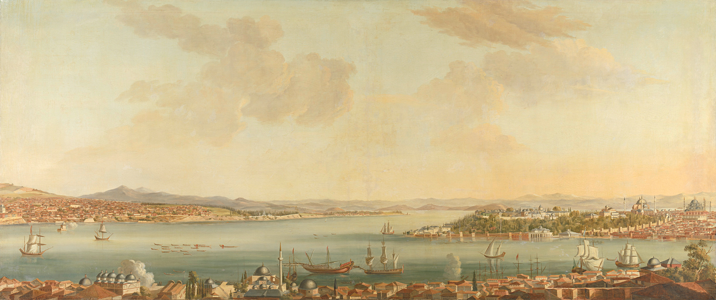


تـرحـال
terhal

Slide 2
Introduction
Travelers exploring Saudi Arabia often struggle to find reliable information about local destinations.
Traditional sources like travel guides and online reviews often fall short, leading to uncertainty and less-than-ideal travel experiences. Moreover, the lack of direct communication with other travelers deprives them of valuable firsthand recommendations.

Slide 3
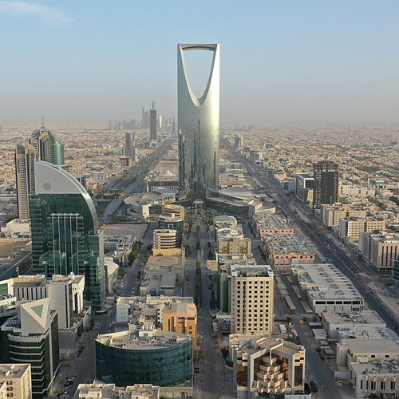
Problem Statement
Exploration enthusiasts find it challenging to discover similar places within Saudi Arabia and connect with people who share their interests and activities, limiting their travel experiences and interactions and making it difficult to organize enjoyable and rewarding trips

Slide 4
Solution
Users can upload photos of places they want to visit.
The app suggests similar locations in Saudi Arabia based on uploaded photos.
Displays profiles of users who have visited these recommended places, facilitating trip planning and enhancing personal connections.
Making trip planning more convenient and facilitating connections with others.

Slide 5



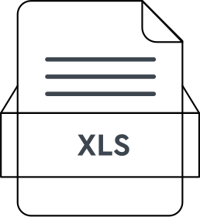

Pipeline
User
Result
Model
Vector DB Search
Qdrant
Model

Slide 6
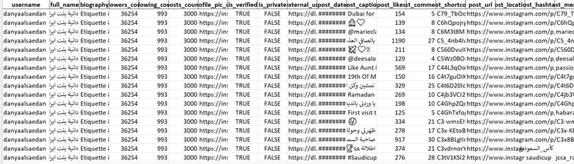
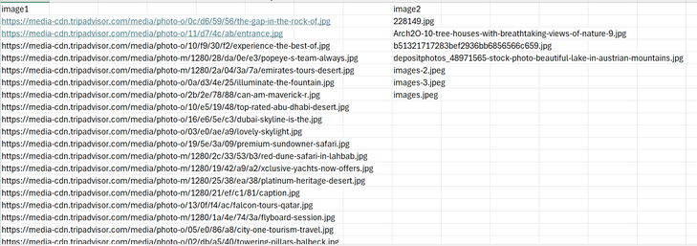
Data overview
Dataset
2800
Dataset
400

Slide 7



Data Modeling
Model
ResNet50
ImageClassification.

Slide 8
App functionality
Connect with Other Travelers
Location Suggestions
Explore user profiles of those who have visited the recommended places, facilitating trip planning and enhancing personal connections.
Explore similar locations in Saudi Arabia based on the uploaded photos.

Slide 9
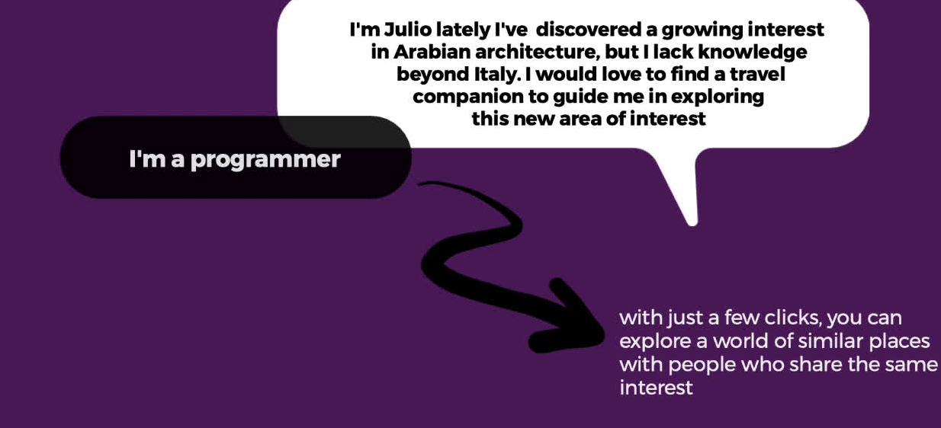
DEMO

Slide 10
Conclusion
Challenge
Identifying and filtering out Instagram accounts that use Photoshop in their posts.
Future Work
Partner with local travel services to offer users seamless booking options for recommended places.
Users can save recommended places to a list for future trip planning.
Users can enter their budget, interests, and available days off, and the app will suggest places that match their criteria.
Provide audio-guided tours at popular attractions and historic sites
Identifying and filtering out Instagram accounts that use Photoshop in their posts.

Slide 11

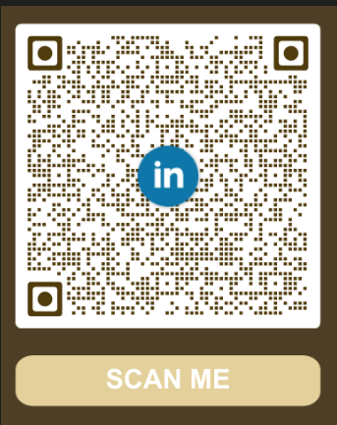

Tasneem Aljahdali
Qout Alzyadi
Raneem Aljabri

Slide 12
Thank You
Any questions ?

